Slide 1

Chapter 6 The Link Layer
and LANs
Computer Networking: A Top-Down Approach 8th edition Jim Kurose, Keith Ross Pearson, 2020
Acknowledgement: Based on the textbook’s website: https://gaia.cs.umass.edu/kurose_ross/index.php
Notes:
Version History
8.0 (May 2020)
All slides reformatted for 16:9 aspect ratio
All slides updated to 8th edition material
Use of Calibri font, rather that Gill Sans MT
Add LOTS more animation throughout
lighter header font
Updated datacenter slides, day-in-the-life
8.2 (July 2023): changes from 8.0
Minor updates throughout, including removal of master/slave
A few new slides added (transportation analogy, UMass LAN example, extended LANs)
Couple of not-used slides now hidden.

Slide 2

Link layer, LANs: roadmap
introduction
error detection, correction
multiple access protocols
LANs
addressing, ARP
Ethernet
switches
VLANs
link virtualization: MPLS
data center networking
a day in the life of a web request

Slide 3









Multiple access links, protocols
two types of “links”:
point-to-point
point-to-point link between Ethernet switch, host
PPP for dial-up access
broadcast (shared wire or medium)
old-school Ethernet
upstream HFC in cable-based access network
802.11 wireless LAN, 4G/4G. satellite
shared wire (e.g.,
cabled Ethernet)
shared radio: 4G/5G
shared radio: WiFi
shared radio: satellite
humans at a cocktail party
(shared air, acoustical)

Slide 4
Multiple access protocols
single shared broadcast channel
two or more simultaneous transmissions by nodes: interference
collision if node receives two or more signals at the same time
multiple access protocol
distributed algorithm that determines how nodes share channel, i.e., determine when node can transmit
communication about channel sharing must use channel itself!
no out-of-band channel for coordination

Slide 5
An ideal multiple access protocol
given: multiple access channel (MAC) of rate R bps
desiderata:
1. when one node wants to transmit, it can send at rate R.
2. when M nodes want to transmit, each can send at average rate R/M
3. fully decentralized:
no special node to coordinate transmissions
no synchronization of clocks, slots
4. simple

Slide 6
MAC protocols: taxonomy
three broad classes:
channel partitioning
divide channel into smaller “pieces” (time slots, frequency, code)
allocate piece to node for exclusive use
random access
channel not divided, allow collisions
“recover” from collisions
“taking turns”
nodes take turns, but nodes with more to send can take longer turns

Slide 7
Channel partitioning MAC protocols: TDMA
TDMA: time division multiple access
access to channel in “rounds”
each station gets fixed length slot (length = packet transmission time) in each round
unused slots go idle
example: 6-station LAN, 1,3,4 have packets to send, slots 2,5,6 idle
6-slot
frame
6-slot
frame
1
3
4
1
3
4

Slide 8
Channel partitioning MAC protocols: FDMA
FDMA: frequency division multiple access
channel spectrum divided into frequency bands
each station assigned fixed frequency band
unused transmission time in frequency bands go idle
example: 6-station LAN, 1,3,4 have packet to send, frequency bands 2,5,6 idle
time
frequency bands
FDM cable

Slide 9
Random access protocols
when node has packet to send
transmit at full channel data rate R
no a priori coordination among nodes
two or more transmitting nodes: “collision”
random access protocol specifies:
how to detect collisions
how to recover from collisions (e.g., via delayed retransmissions)
examples of random access MAC protocols:
ALOHA, slotted ALOHA
CSMA, CSMA/CD, CSMA/CA

Slide 10
Slotted ALOHA
operation:
when node obtains fresh frame, transmits in next slot
if no collision: node can send new frame in next slot
if collision: node retransmits frame in each subsequent slot with probability p until success
t₀
t₀+1
assumptions:
all frames same size
time divided into equal size slots (time to transmit 1 frame)
nodes start to transmit only slot beginning
nodes are synchronized
if 2 or more nodes transmit in slot, all nodes detect collision
randomization – why?

Slide 11
Slotted ALOHA
node 1
1
1
1
1
C: collision
S: success
E: empty
node 2
2
2
2
node 3
3
3
3
C
E
C
S
E
C
E
S
S
Pros:
single active node can continuously transmit at full rate of channel
highly decentralized: only slots in nodes need to be in sync
simple
Cons:
collisions, wasting slots
idle slots
nodes may be able to detect collision in less than time to transmit packet
clock synchronization
Notes:
Slotted ALOHA would appear to have many advantages. Unlike channel partitioning, slotted ALOHA allows a node to transmit continuously at the full rate, R, when that node is the only active node. (A node is said to be active if it has frames to send.) Slotted ALOHA is also highly decentralized, because each node detects collisions and independently decides when to retransmit. (Slotted ALOHA does, however, require the slots to be synchronized in the nodes; shortly we’ll discuss an unslotted version of the ALOHA protocol, as well as CSMA protocols, none of which require such synchronization.) Slotted ALOHA is also an extremely simple protocol.

Slide 12

Slotted ALOHA: efficiency
efficiency: long-run fraction of successful slots (many nodes, all with many frames to send)
suppose: N nodes with many frames to send, each transmits in slot with probability p
prob that given node has success in a slot = p(1-p)^{N-1}
prob that any node has a success = Np(1-p)^{N-1}
max efficiency: find p* that maximizes Np(1-p)^{N-1}
for many nodes, take limit of Np*(1-p*)^{N-1} as N goes to infinity, gives:
max efficiency = 1/e = .37
at best: channel used for useful transmissions 37% of time!
Notes:
Suppose there are N nodes. Then the probability that a given slot is a successful slot is the probability that one of the nodes transmits and that the remaining N - 1 nodes do not transmit. The probability that a given node transmits is p; the probability that the remaining nodes do not transmit is (1 - p)N-1. Therefore, the probability a given node has a success is p(1 - p)N-1. Because there are N nodes, the probability that any one of the N nodes has a success is Np(1 - p)N - 1.
only 37 percent of the slots do useful work. Thus, the effective transmission rate of the channel is not R bps but only 0.37 R bps! A similar analysis also shows that 37 percent of the slots go empty and 26 percent of slots have collisions.

Slide 13
CSMA (carrier sense multiple access)
simple CSMA: listen before transmit:
if channel sensed idle: transmit entire frame
if channel sensed busy: defer transmission
human analogy: don’t interrupt others!
CSMA/CD: CSMA with collision detection
collisions detected within short time
colliding transmissions aborted, reducing channel wastage
collision detection easy in wired, difficult with wireless
human analogy: the polite conversationalist

Slide 14
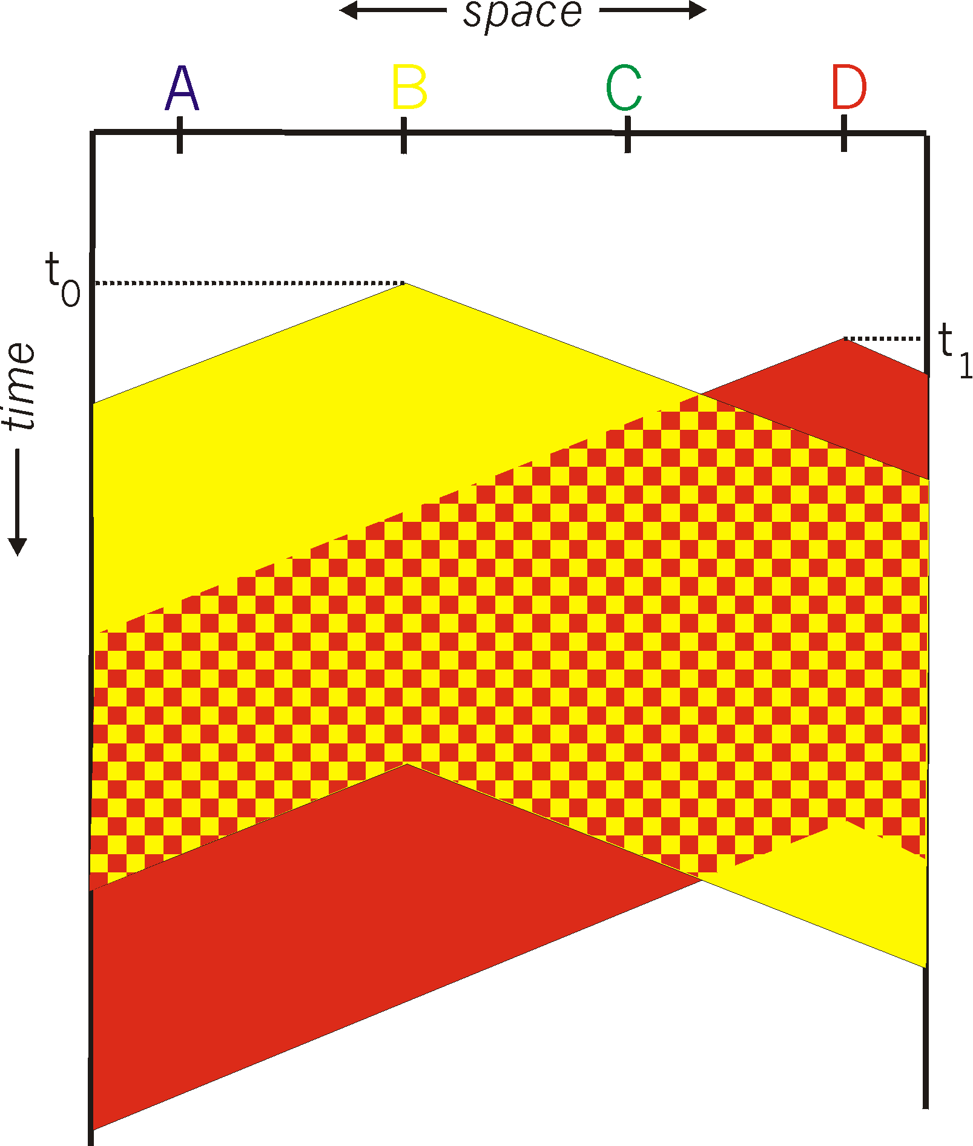
CSMA: collisions
spatial layout of nodes
collisions can still occur with carrier sensing:
propagation delay means two nodes may not hear each other’s just-started transmission
collision: entire packet transmission time wasted
distance & propagation delay play role in in determining collision probability

Slide 15
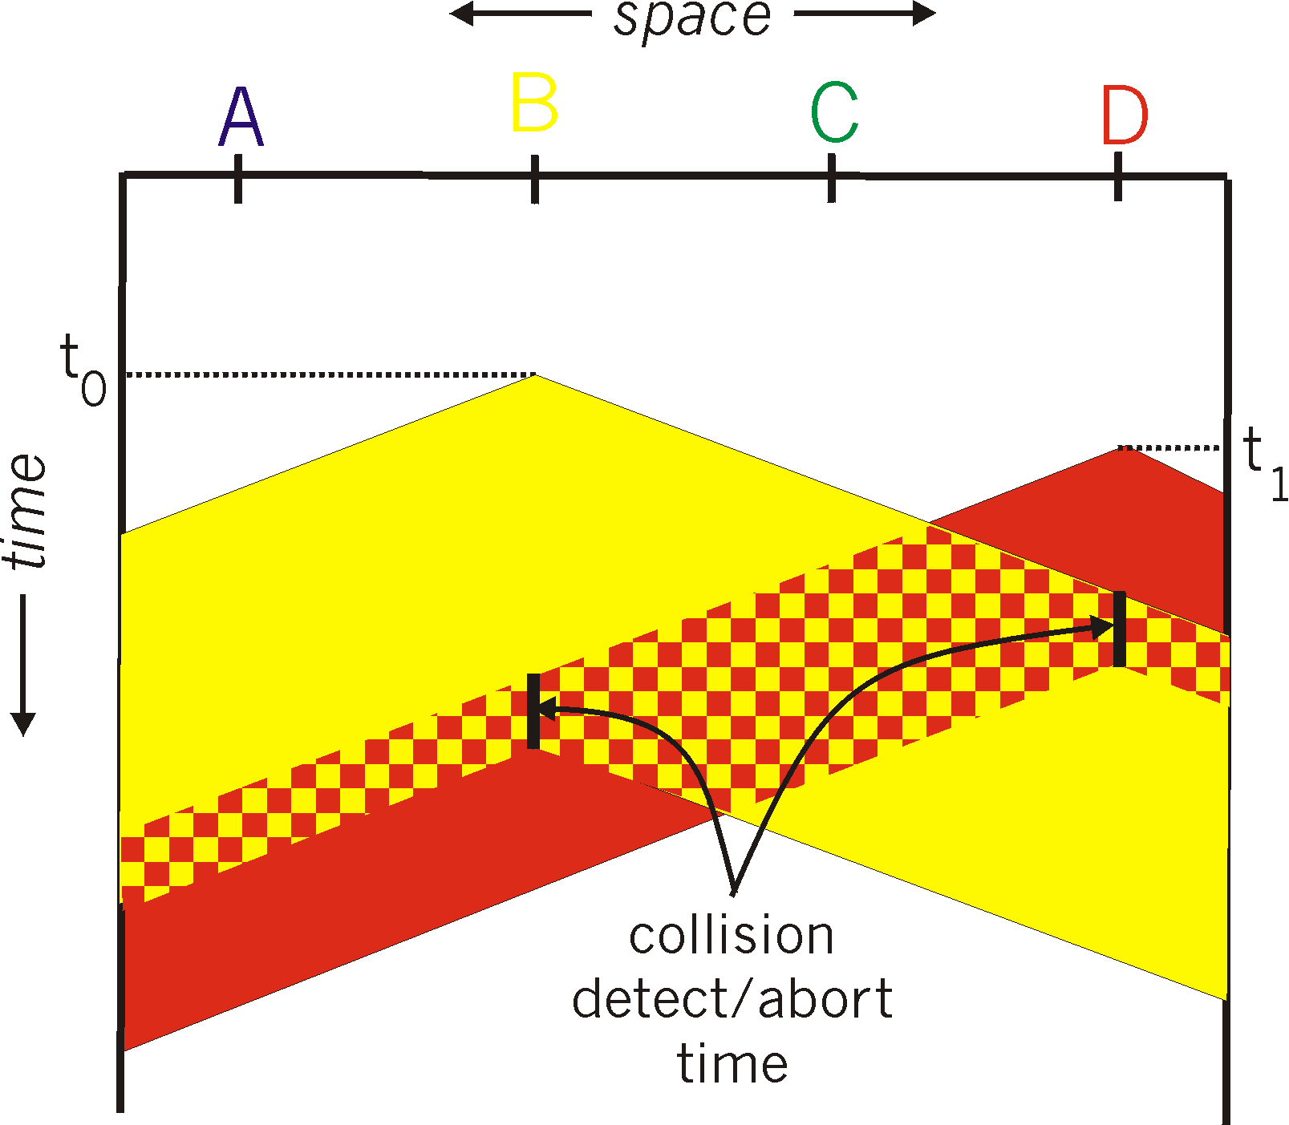
CSMA/CD:
spatial layout of nodes
CSMA/CD reduces the amount of time wasted in collisions
transmission aborted on collision detection

Slide 16
Ethernet CSMA/CD algorithm
Ethernet receives datagram from network layer, creates frame
If Ethernet senses channel:
if idle: start frame transmission.
if busy: wait until channel idle, then transmit
If entire frame transmitted without collision - done!
If another transmission detected while sending: abort, send jam signal
After aborting, enter binary (exponential) backoff:
after mth collision, chooses K at random from {0,1,2, …, 2^{m}-1}. Ethernet waits K·512 bit times, returns to Step 2
more collisions: longer backoff interval
Notes:
For Ethernet, the actual amount of time a node waits is K # 512 bit times (i.e., K times the amount of time needed to send 512 bits into the Ethernet) and the maxi- mum value that n can take is capped at 10.

Slide 17
CSMA/CD efficiency
T_{prop} = max prop delay between 2 nodes in LAN
t_{trans} = time to transmit max-size frame
efficiency goes to 1
as t_{prop} goes to 0
as t_{trans} goes to infinity
better performance than ALOHA: and simple, cheap, decentralized!
Notes:
let dprop denote the maximum time it takes signal energy to propagate between any two adapters. Let dtrans be the time to transmit a maximum-size frame (approximately 1.2 msecs for a 10 Mbps Ethernet).

Slide 18
“Taking turns” MAC protocols
channel partitioning MAC protocols:
share channel efficiently and fairly at high load
inefficient at low load: delay in channel access, 1/N bandwidth allocated even if only 1 active node!
random access MAC protocols
efficient at low load: single node can fully utilize channel
high load: collision overhead
“taking turns” protocols
look for best of both worlds!

Slide 19

“Taking turns” MAC protocols
polling:
centralized controller “invites” other nodes to transmit in turn
typically used with “dumb” devices
concerns:
polling overhead
latency
single point of failure (master)
Bluetooth uses polling
data
poll
centralized controller
data
client devices
Notes:
The first drawback is that the protocol introduces a polling delay—the amount of time required to notify a node that it can transmit. If, for example, only one node is active, then the node will transmit at a rate less than R bps, as the master node must poll each of the inactive nodes in turn each time the active node has sent its maximum number of frames. The second drawback, which is potentially more serious, is that if the master node fails, the entire channel becomes inoperative. The Bluetooth protocol, which we will study in Section 6.3, is an example of a polling protocol.

Slide 20
“Taking turns” MAC protocols
T
token passing:
control token message explicitly passed from one node to next, sequentially
transmit while holding token
concerns:
token overhead
latency
single point of failure (token)
(nothing
to send)
T
data
Notes:
no master node
But it has its problems as well. For example, the failure of one node can crash the entire channel. Or if a node accidentally neglects to release the token, then some recovery procedure must be invoked to get the token back in circulation.

Slide 21
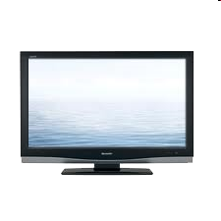


Cable access network: FDM, TDM and random access!
Internet frames, TV channels, control transmitted
downstream at different frequencies
cable headend
…
CMTS
…
splitter
cable
modem
ISP
cable modem
termination system
multiple downstream (broadcast) FDM channels: up to 1.6 Gbps/channel
single CMTS transmits into channels
multiple upstream channels (up to 1 Gbps/channel)
multiple access: all users contend (random access) for certain upstream channel time slots; others assigned TDM

Slide 22
Cable access network:
MAP frame for
Interval [t1, t2]
CMTS
Downstream channel i
Upstream channel j
cable headend
t₁
t₂
Residences with cable modems
Minislots containing
minislots request frames
Assigned minislots containing cable modem
upstream data frames
DOCSIS: data over cable service interface specification
FDM over upstream, downstream frequency channels
TDM upstream: some slots assigned, some have contention
downstream MAP frame: assigns upstream slots
request for upstream slots (and data) transmitted random access (binary backoff) in selected slots

Slide 23
Summary of MAC protocols
channel partitioning, by time, frequency or code
Time Division, Frequency Division
random access (dynamic),
ALOHA, S-ALOHA, CSMA, CSMA/CD
carrier sensing: easy in some technologies (wire), hard in others (wireless)
CSMA/CD used in Ethernet
CSMA/CA used in 802.11
taking turns
polling from central site, token passing
Bluetooth, FDDI, token ring

